Slide 1
Combined Cycle Power Plant ML Project
By David Pham Le
Duke University - Machine Learning Foundations for Product Managers

Slide 2
Goal =
Predict the electrical energy output of the CCPP

Slide 3
Datasets
Data columns = hourly average ambient variables
- Temperature (AT) in the range 1.81°C to 37.11°C,
- Ambient Pressure (AP) in the range 992.89-1033.30 millibar,
- Relative Humidity (RH) in the range 25.56% to 100.16%
- Exhaust Vacuum (V) in the range 25.36-81.56 cm Hg
- Net hourly electrical energy output (PE) 420.26-495.76 MW (Target we are trying to predict)

Slide 4
Approach
(a) Modeling Platform
Python
(b) Evaluation Metrics
Mean Square Error (MSE)
Mean Absolute Error (MAE)
R Square
(c) Algorithm
Linear Regression, Random Forest

Slide 5
Initial Steps
(1) Import libraries
Pandas, Scikit Learn, Matplotlib, Seaborn
(2) Load and explore the data
Read the CSV file containing the data into a pandas DataFrame
(3) Data Processing
Handle any missing values, outliers, or data inconsistencies
Index | AT | V | AP | RH | PE
0 | 14.96 | 41.76 | 1024.07 | 73.17 | 463.26
1 | 25.18 | 62.96 | 1020.04 | 59.08 | 444.37
2 | 5.11 | 39.40 | 1012.16 | 92.14 | 488.56
3 | 20.86 | 57.32 | 1010.24 | 76.64 | 446.48
4 | 10.82 | 37.50 | 1009.23 | 96.62 | 473.90
... | ... | ... | ... | ... | ...
9563 | 16.65 | 49.69 | 1014.01 | 91.00 | 460.03
9564 | 13.19 | 39.18 | 1023.67 | 66.78 | 469.62
9565 | 31.32 | 74.33 | 1012.92 | 36.48 | 429.57
9566 | 24.48 | 69.45 | 1013.86 | 62.39 | 435.74
9567 | 21.60 | 62.52 | 1017.23 | 67.87 | 453.28
9568 rows × 5 columns

Slide 6
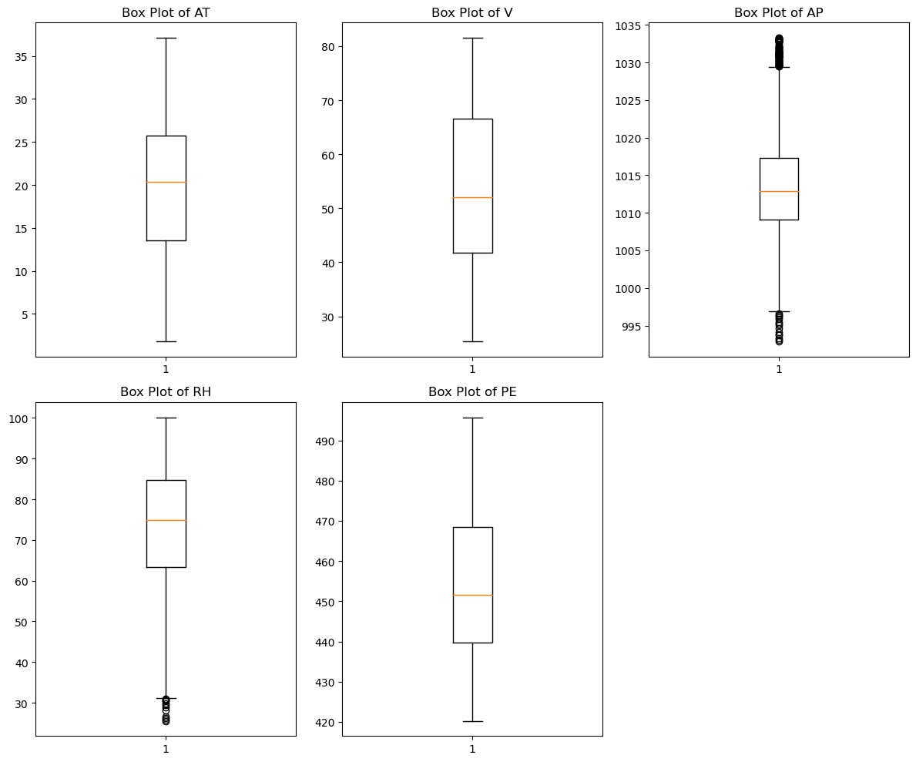
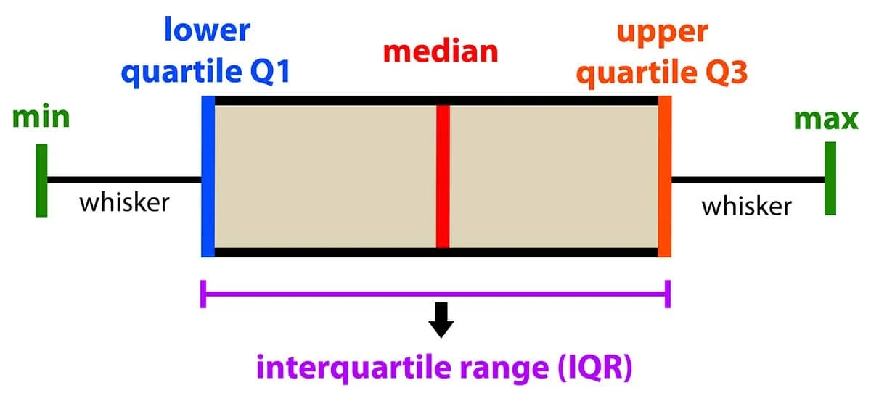
Data Processing
(1) NaN, empty cell
No NaN or empty cell (dtype: bool)
(2) Check for outliers
Small candles, outliers close to min max
Source: Simple Psychology
Boxplot charts to check for outliers

Slide 7
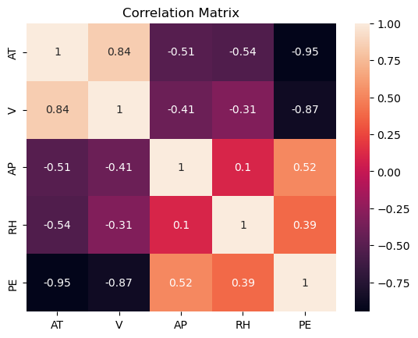
Features relationships
(-) Strong negative
For Temperature (AT) and Exhaust Vacuum (V) compared to Net hourly electrical energy output (PE)
(+) Moderate positive
For Ambient Pressure (AP) and Relative Humidity (RH) compared to PE

Slide 8
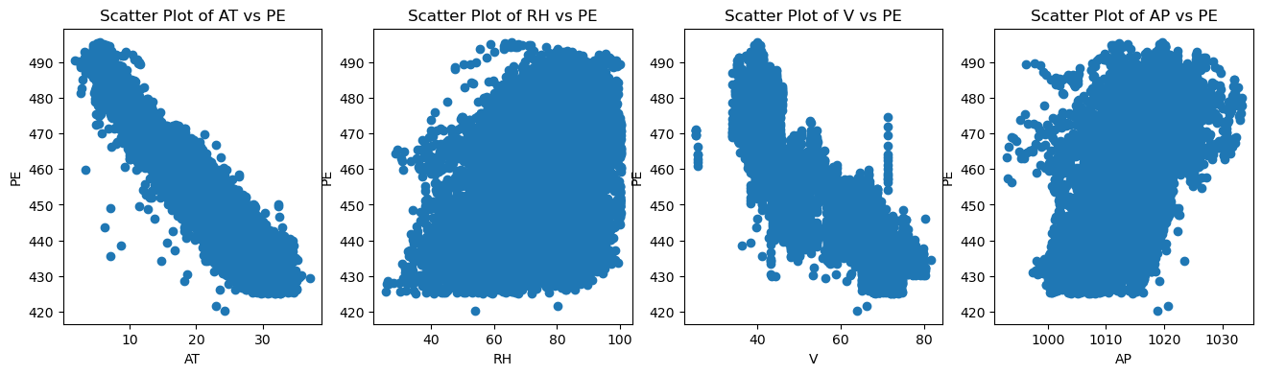
Features relationships
Strong linear relationship
Between AT vs PE and V vs PE

Slide 9
Train Test Split
(1) Separate the features from the target variable
Features: ['AT', 'V', 'AP', 'RH']
Outputs: ['PE']
(2) Splitting the data into training (80%), cross-validation (10%), and testing (10%)

Slide 10
Compared LR and RF models
Cross-Validation MSE: 19.941 Cross-Validation MAE: 3.615 Cross-Validation R-squared: 0.931
Test MSE: 20.606 Test MAE: 3.577 Test R-squared: 0.929
Cross-Validation MSE: 10.162 Cross-Validation MAE: 2.354 Cross-Validation R-squared: 0.965 Test MSE: 10.914 Test MAE: 2.306 Test R-squared: 0.962
Linear Regression
Random Forest

Slide 11
Fine tuning - Features selection
Cross-Validation MSE: 10.389 Cross-Validation MAE: 2.384 Cross-Validation R-squared: 0.964
Test MSE: 11.510 Test MAE: 2.314 Test R-squared: 0.960
Cross-Validation MSE: 12.655 Cross-Validation MAE: 2.654 Cross-Validation R-squared: 0.956
Test MSE: 12.595 Test MAE: 2.520 Test R-squared: 0.957
RF (AT,V,AP)
RF (AT,V,RH)
Cross-Validation MSE: 13.935 Cross-Validation MAE: 2.771 Cross-Validation R-squared: 0.952
Test MSE: 13.765 Test MAE: 2.630 Test R-squared: 0.953
Cross-Validation MSE: 10.162 Cross-Validation MAE: 2.354 Cross-Validation R-squared: 0.965 Test MSE: 10.914 Test MAE: 2.306 Test R-squared: 0.962
RF (AT,V)
RF (AT,V,AP,RH)

Slide 12
Thanks!
linkedin.com/in/davidphamle
davidphamle.com
Please, keep this slide as attribution

Slide 13
01
02
03
04
Modeling approach
Model building
Model evaluation
Model interpretation

Slide 14
01
Modeling approach

Slide 15
02
Model building

Slide 16
03
Model evaluation

Slide 17
04
Model interpretation

